Slide 1


Minh Pham
May 20, 2022

Slide 2

Outline
Executive Summary
Introduction
Methodology
Results
Conclusion
Appendix

Slide 3
Executive Summary
SpaceX is the only private space company ever to return boosters back to surface and reuse those first stages for future missions. With the help of data and data scientists, SpaceX has been able to determine the cost and improve the outcome for each launches.
SpaceX has utilized machine learning to the process and saved million of dollars, showing us the importance of data and how it can help us in the future

Slide 4
Introduction
In this study, we helped SpaceX improve their data-driven decisions by analyzing their launches and the outcome for each launch.
Determine criteria and parameters of a successful launch
Determine cost for each launch and the potential saving in future missions

Slide 5

Section 1

Slide 6
Methodology
Executive Summary
Data collection methodology:
SpaceX API
Web Scrabbing
Perform data wrangling
Split data into two categories base on the outcome of the landing (Success or Fail)
Perform exploratory data analysis (EDA) using visualization and SQL
Perform interactive visual analytics using Folium and Plotly Dash
Perform predictive analysis using classification models
Split data into training and testing sets; Choose the best parameters for the data sets

Slide 7
Data Collection
Data Collected via SpaceX API & Web Scrapping
Using Panda DataFrame to store data
Filter dataframe to include only relevant data – Falcon 9 Launches
Data Wrangling
Clean and fix missing data
Data Ready to use for analysis

Slide 8
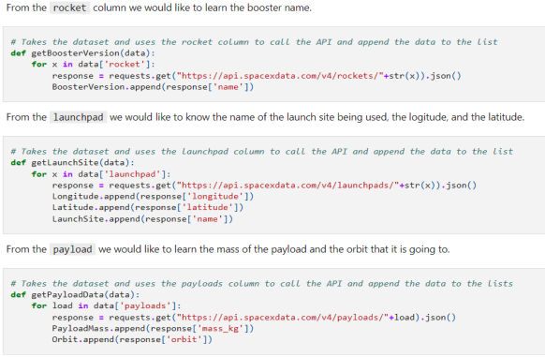
Data Collection – SpaceX API
Use REST API for relevant data. Use Jupyter Notebook to connect to the API and Json to convert to usable dataframe

Slide 9
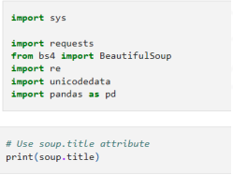
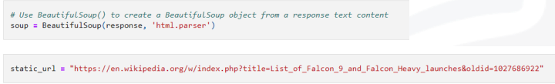
Data Collection - Scraping
Web Scrapping to collect Falcon 9 records from Wikipedia. Data was exacted from a HTML table then converted using Panda dataframe

Slide 10

Data Wrangling
Data Wrangling, data cleaning process, is an important first step toward usable data. In this first step, we remove faulty data, deal with missing values and transform the data into the correct format for the project.

Slide 11
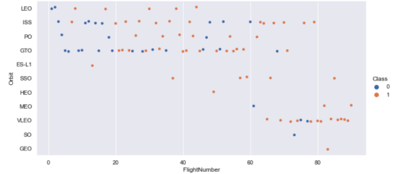
EDA with Data Visualization
Panda & Matplotlib for data visualization

Slide 12
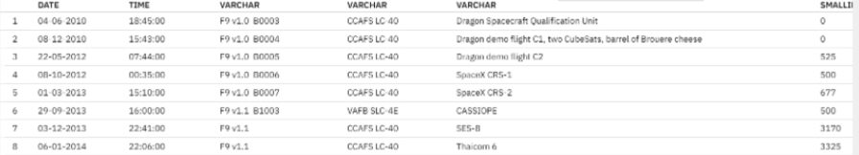
EDA with SQL
SQL can be used in our project by loading the database into the DB2 on IBM Cloud then use SQL queries to extract relevant information.

Slide 13
Build an Interactive Map with Folium
Folium is a powerful python library that we can use to create Leaflet maps.
We used markers on the map to pinpoint points of interest:
NASA Space Center
Outcomes at specific launch sites
Whether launches success or fail
Closest city/ Highway/ etc.

Slide 14
Build a Dashboard with Plotly Dash
To have a better understanding & visualization of the data, Plotly Dash was used to create interactive dashboards.
Dashboards are a great way to show important aspects of the dataset.
Our focus was on the outcome ratio of the launches as well as the clear way of visualization the impact of the weight of the rocket on the outcome of each launches.

Slide 15
Predictive Analysis (Classification)
Machine Learning Models:
Logistic Regression
K-nearest neighbor (KNN)
Decision Tree
Support vector machine (SVM)
After each process, we used confusion matric to determine the classifer with the best performance

Slide 16

Section 2

Slide 17
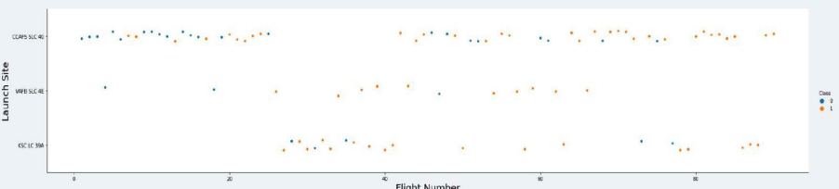
Flight Number vs. Launch Site

Slide 18
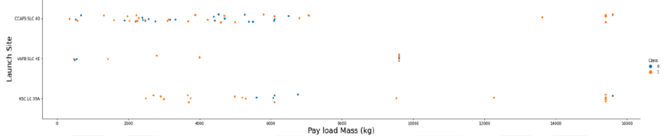
Payload vs. Launch Site

Slide 19
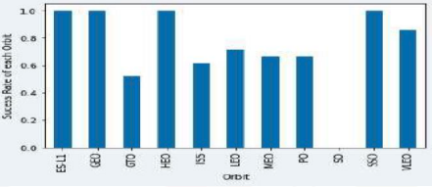
Success Rate vs. Orbit Type

Slide 20
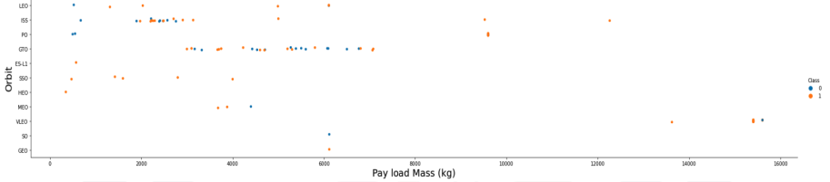
Payload vs. Orbit Type

Slide 21

Launch Success Yearly Trend
Yearly trend, from the plots, the launches are improving over time. We are slowly approaching a success rate of 1.
However, the last steps are the most difficult one since the curve in not as stiff positive. Expecting slow and steady improvement in the future

Slide 22
All Launch Site Names
Select distinct (launch_site)
From spacexdataset
Order by launch_site_ASC
Results:
CCAFS LC-40
CCAFS SLC-40
KSC LC-39A
VAFB SLC-4E

Slide 23
Launch Site Names Begin with 'CCA'
Select distinct(launch_site)
From spacexdataset
Where lauch_site LIKE ‘CCA%’
Order by launch_site ASC
Results:
CCAFS LC-40
CCAFS SLC-40

Slide 24
Total Payload Mass
Select sum(payload_mass_kg) as total_mass
From spacexdataset
Where customer=‘NASA (CRS)’
Results:
Total_mass=38209

Slide 25
Average Payload Mass by F9 v1.1
Select avg(payload_mass_kg) as average_mass
From spacexdataset
Where booster_verson=‘F9 v1.1’
Results:
Average_mass=589

Slide 26
First Successful Ground Landing Date
Select from
(select count(mission_outcome) as success
From spacexdataset
Where mission_outcome LIKE ‘%success%’)
(select count(mission_outcome) as failure
From spacexdataset
Where mission_outcome LIKE ‘%failure%’)
Results:
Success =100
Failure = 1

Slide 27
Boosters Carried Maximum Payload
Select *booster_verson, payload_mass_kg
From spacexdataset
Where payload_max_kg=
Select(max(payload_max_kg) from spacexdataet)

Slide 28
2015 Launch Records
Select booster_version, launch_site, year(date) AS date
From spacexdataset
Where landing_outcome LIKE ‘%failure%’
And year(date)=2015

Slide 29
Rank Landing Outcomes Between 2010-06-04 and 2017-03-20
Select count(landing_outcome) as amount, landing_outcome
From spacexdataset
Where ‘date’ > ‘06-03-2010’ and ‘date’<’03-21-2017’
Group by landing_outcome
Order by amount DESC
Result:

Slide 30

Section 3

Slide 31
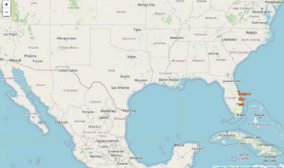
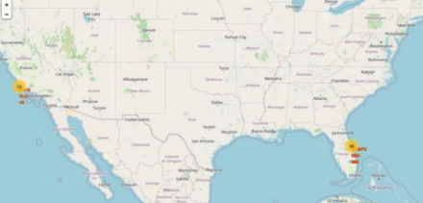
Launch Site Locations

Slide 32

Section 4

Slide 33
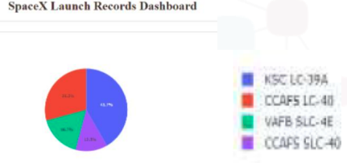
Plotly Dashboard
Pie chart shows the percentage of each value for the ease of comparison.
Launch site KSC LC-39A is the most successful launch site.

Slide 34
<Dashboard Screenshot 3>
Replace <Dashboard screenshot 3> title with an appropriate title
Show screenshots of Payload vs. Launch Outcome scatter plot for all sites, with different payload selected in the range slider
Explain the important elements and findings on the screenshot, such as which payload range or booster version have the largest success rate, etc.

Slide 35

Section 5

Slide 36
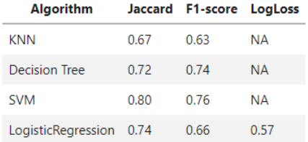
Classification Accuracy

Slide 37
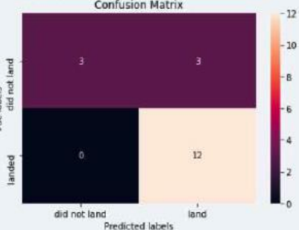
Confusion Matrix
True positive (12): predict land, did land
False positive (3): predict land but fail
False negative (0): predict fail but landed
True negative (3) : predict fail, did fail

Slide 38


